Slide 1


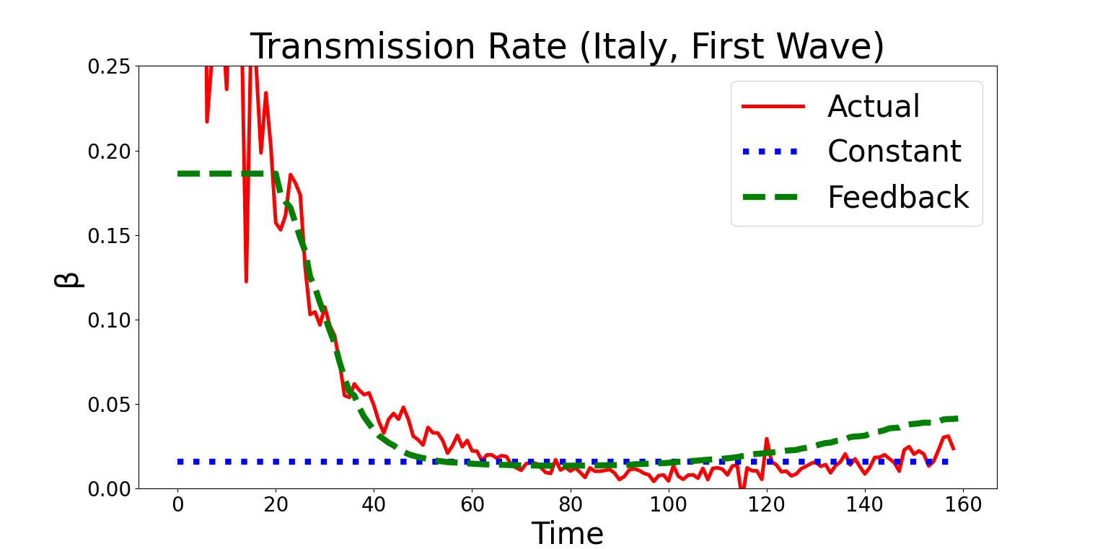
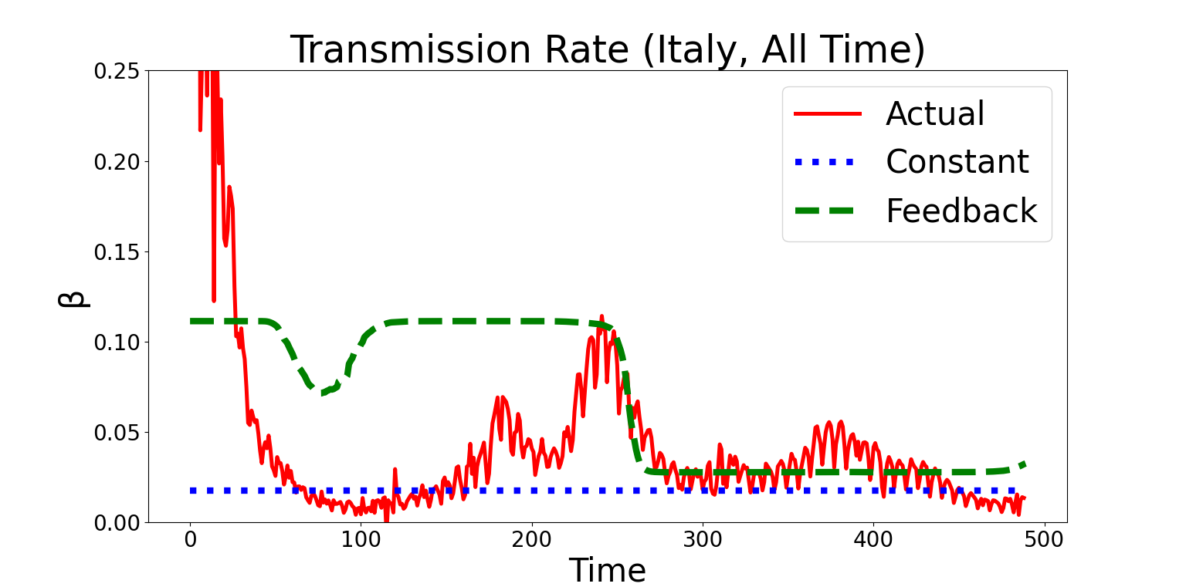
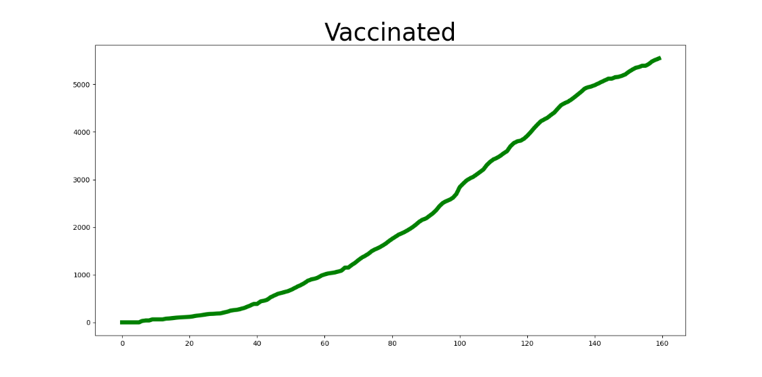
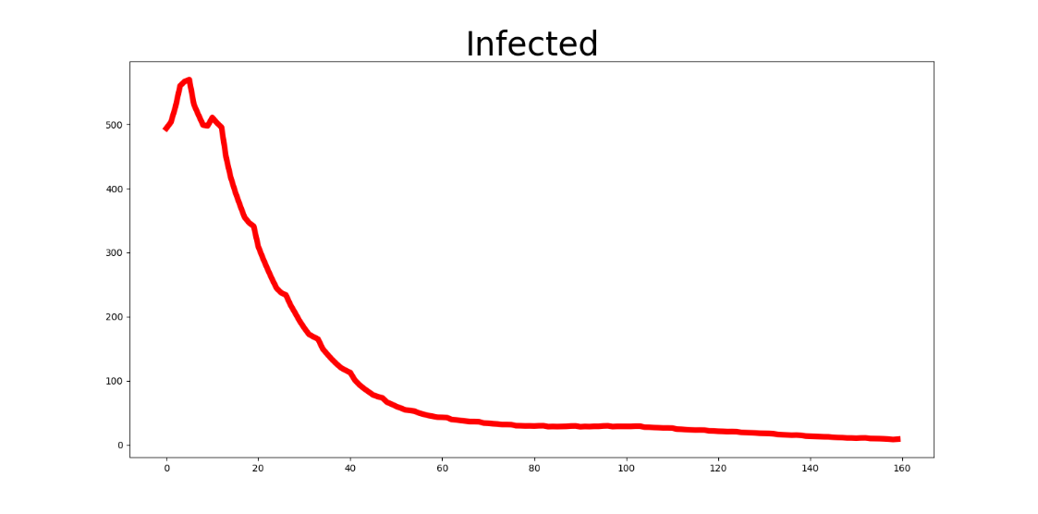
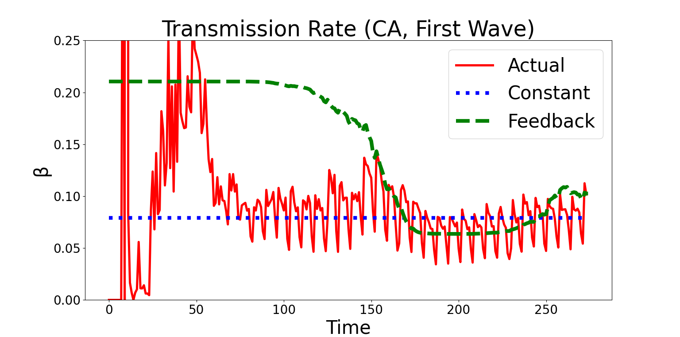
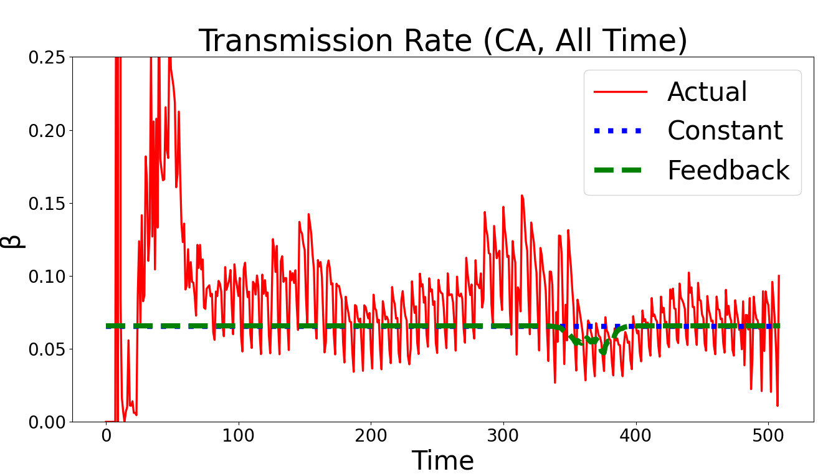
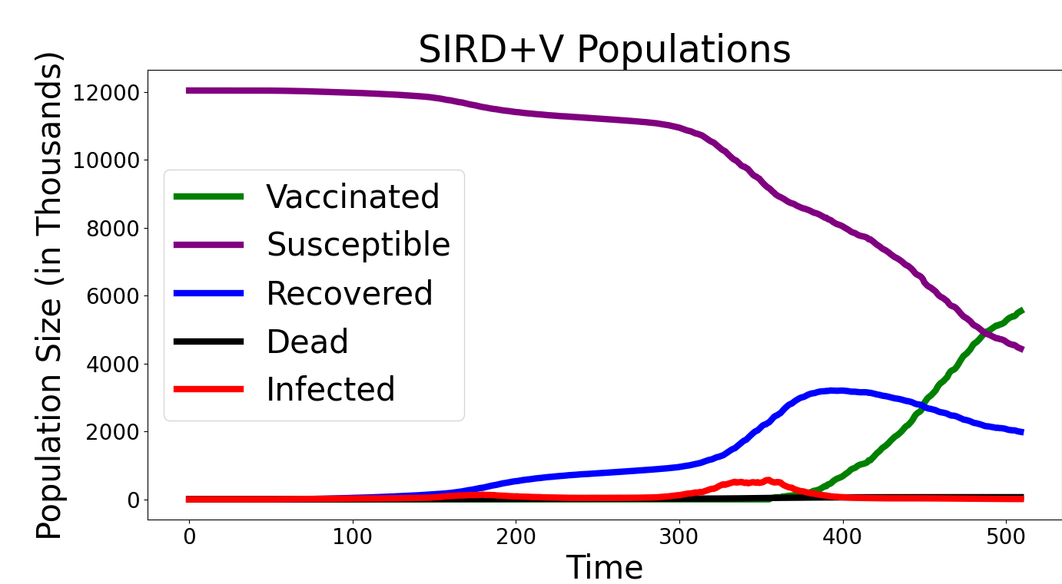
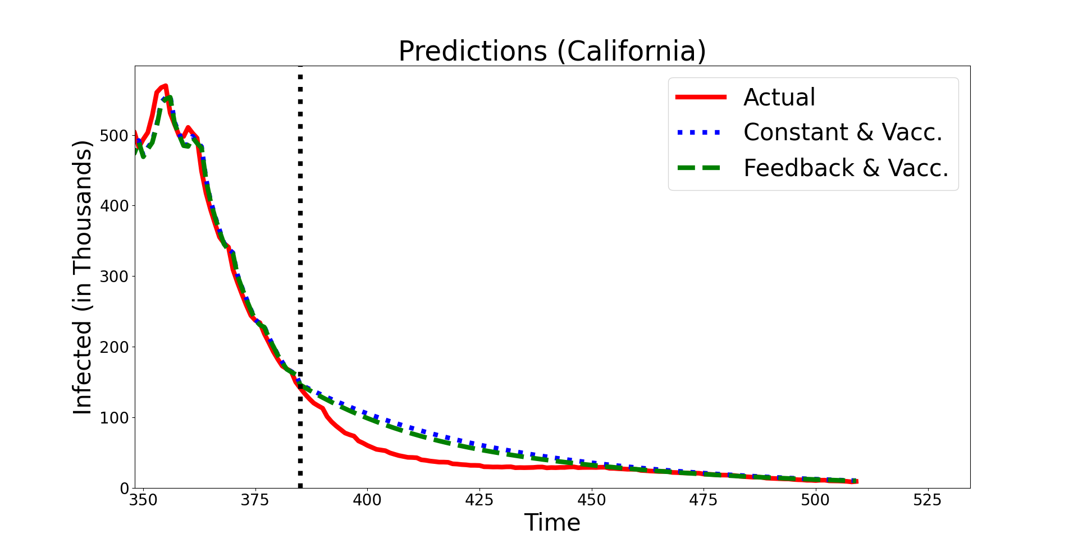
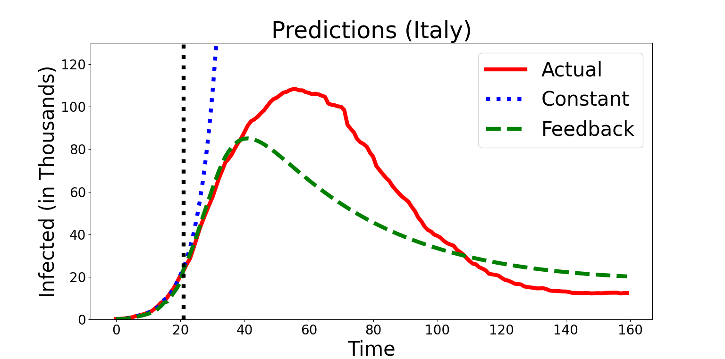
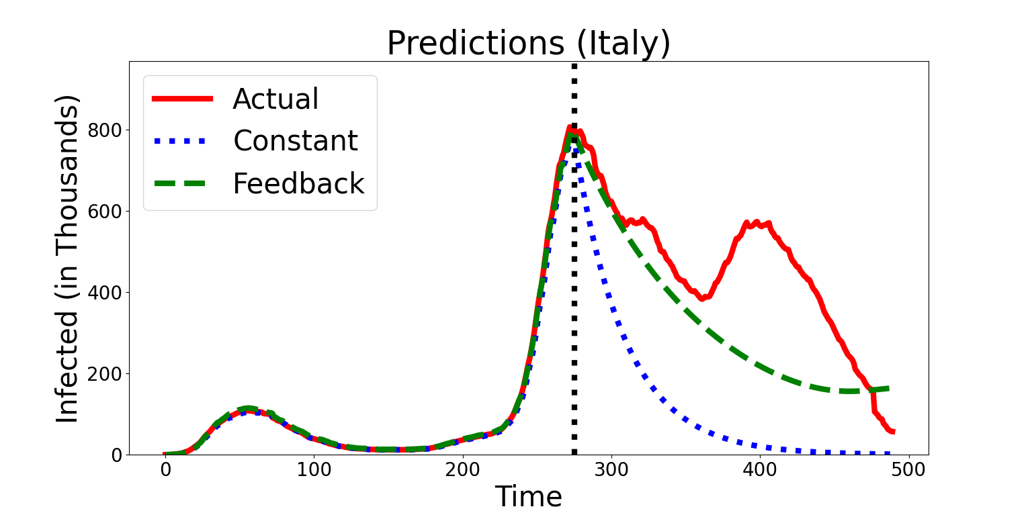
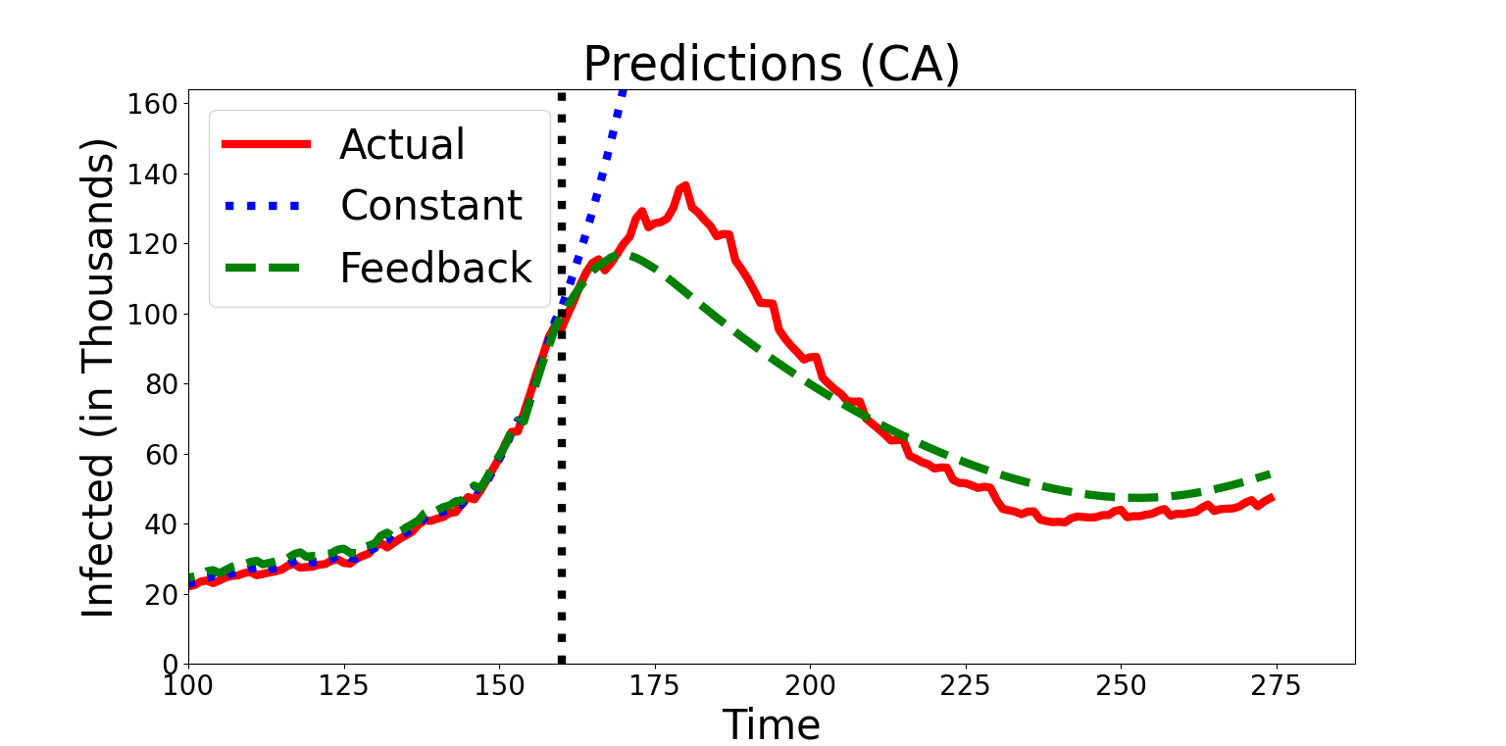
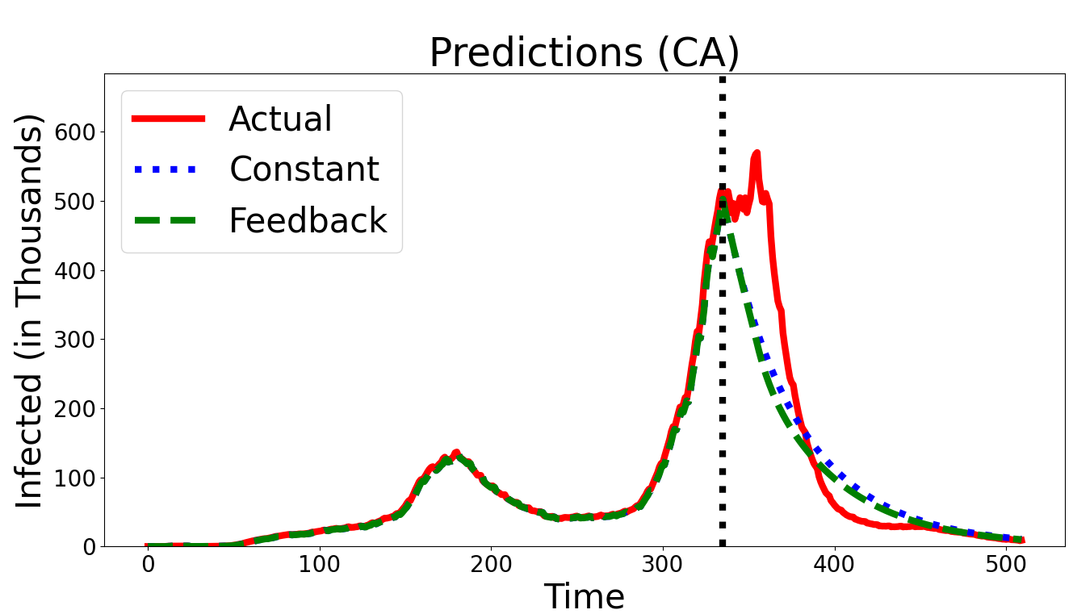
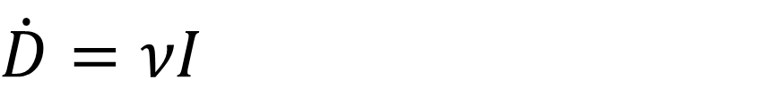

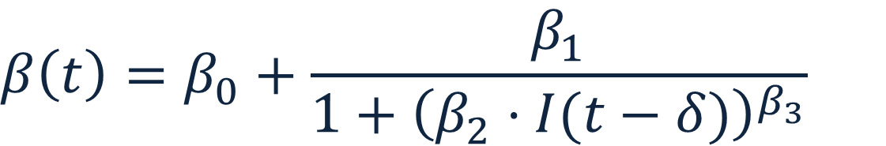
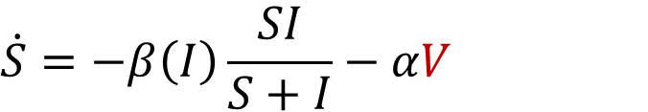
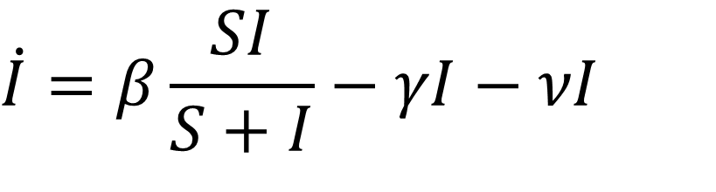
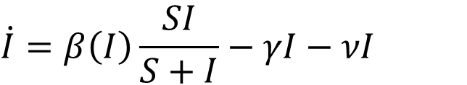

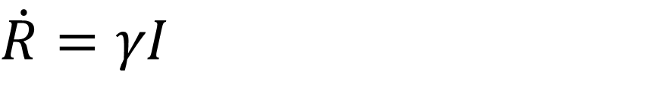
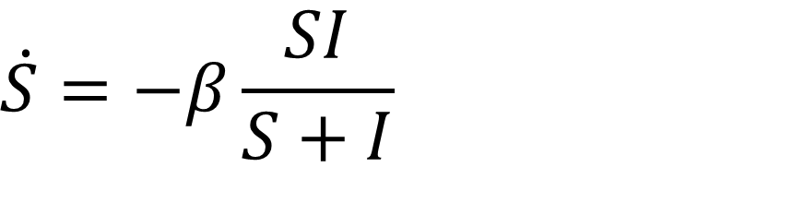
A Feedback SIRD Model for the Spread of Infectious Disease with Application to COVID-19 Pandemic Daniel March, Jeston Bond, and Genti Buzi Department of Mathematics and Computer Science, Biola University
Abstract
Results
Incorporating Vaccines
The COVID-19 global pandemic has highlighted the importance of identifying effective ways to control the spread of an infectious disease in a population. A solid understanding of the dynamics and the underlying mechanisms that govern this spread is an important step toward such a goal. Susceptible-Infected-Recovered (SIR) models and their variants have played an important role in providing such insight. However, these models have limited explanatory and predictive power due to policy and behavior changes over time. Here we present a modified version of the standard SIR models by introducing feedback in the disease transmission rate. We apply this model to publicly available COVID-19 US and international infection data. We show this model is more robust to parameter variations due to public health interventions and has much better explanatory and predictive power
Tracking the Transmission Rate
$$\begin{matrix}\dot{S}=−β\left(I\right)\frac{SI}{S+I}−αV\end{matrix}$$
$$\begin{matrix}\dot{I}=β\left(I\right)\frac{SI}{S+I}−γI−νI\end{matrix}$$
$$\begin{matrix}\dot{R}=γI−\left(1−α\right)V\end{matrix}$$
Vaccinated
$$\begin{matrix}\dot{D}=νI\end{matrix}$$
Infected
Both the SIRD and SIRD feedback model can be adapted to incorporate vaccinations. We make the assumption both recovered and susceptible populations get vaccinated at the same rate.
Little difference is found in comparing the accuracy of the vaccinated with the standard models of SIRD and SIRD feedback when there is low number of vaccinations and current infections are high.
When the number of infections is high, the number of vaccinations will significantly impact the number of newly infected individuals. Thus, high vaccinations are capable of curbing additional waves of the infection, preventing further deaths.
Methods and Data
Data
The data for this project was extracted from publicly available databases. For US data, numbers for daily total infections, deaths, and vaccinations was acquired from the CDC [1]. For Italian data, numbers for current infections, recoveries, and death were acquired from the Italian Department of Civil Protection [2].
For some data sets the recovered population is not reported or unreliable. To approximate the recovered population, we assume infected individuals recover after 14 days.
The susceptible population must be approximated. This is done by scaling the infected, recovered, and dead populations. This scaling factor, q, is solved using gridding and minimizing an objective function.
The feedback SIRD model can better track the disease transmission rate thus providing a better snapshot of the efficacy of public health measures and public behavior.
Model Predictions
The standard SIRD model uses constant transmission rate and therefore any prediction can only show an unconstrained outbreak or decay of the disease. In predicting an unconstrained outbreak, the number of infections rises exponentially until there are no remaining susceptibles to infect.
Unlike the SIRD model, the feedback model can predict increasing and decreasing infections due to the adaptive nature of the transmission rate. By assuming the local population has some delay in how it can react to new case data, either by naturally distancing or formal health guidelines being put into place, we find that the transmission rate can be modeled with a greater accuracy than the standard SIRD model. This allows for the feedback model to be accurate for a longer duration, while the standard SIRD model deviates rapidly after some period.
$$S\left(t\right)=q⋅Population −(I\left(t\right)+R(t)+D(t)$$
β
γ
R
S
I
Conclusion
SIRD Model
$$\begin{matrix}\dot{S}=−β\frac{SI}{S+I}\end{matrix}$$
ν
D
S(t) – population proportion that is susceptible
I(t) – population proportion that is infected
R(t) – population proportion that has recovered
D(t) – population proportion that has died
γ – the rate at which infected recover
ν – the rate at which infected die
We have demonstrated the SIRD feedback model has significant advantages of the SIRD model.
Better explains the model dynamics.
The feedback model has adaptive transmission rate β which can better model the public and government reaction to the disease.
The feedback model is capable of modeling waves of infection, while the SIRD only predicts either a disease decay or an unconstrained outbreak spike.
Better predicts disease spread
The standard SIRD model is only capable of predicting exponential type growth and decay (constant β). While the feedback model is more robust and more reliable in predicting the progression of infections in a wider range of conditions.
$$\begin{matrix}\dot{I}=β\frac{SI}{S+I}−γI−νI\end{matrix}$$
$$\begin{matrix}\dot{R}=γI\end{matrix}$$
$$\begin{matrix}\dot{D}=νI\end{matrix}$$
β – the transmission rate (the rate at which infected infect susceptible)
This model has been applied successfully on the Italian dataset [3]. Our model and results are consistent with these previous findings.
γ
R
S
β
I
Incorporating Feedback
ν
D
References
The transmission rate is replaced by a time varying beta based on the number of current infections after some delay δ (normally δ=14). The nonlinear variables are solved by gridding and are positive.
https://data.cdc.gov/Case-Surveillance/United-States-COVID-19-Cases-and-Deaths-by-State-o/9mfq-cb36
https://github.com/pcm-dpc/COVID-19
Giuseppe C. Calafiore, Carlo Novara, Corrado Possieri, A time-varying SIRD model for the COVID-19 contagion in Italy, Annual Reviews in Control, Volume 50, 361-372 (2020)
$$\begin{matrix}β\left(t\right)=β_{0}+\frac{β_{1}}{1+{\left(β_{2}⋅I(t−δ)\right)}^{β_{3}}}\end{matrix}$$

